Slide 1
Ultra Automatic Espresso Machine
University of Utah
Nathan Donaldson
Ben Nagel Aaron Pabst
Notes:
Hi. our names are unimportant. You don’t want to be here. Neither do we. We’re building an espresso machine on speed. Introduction complete.

Slide 2
Overview
Our project aims to:
Bring personalization and automation into making espresso
Be fully automatic, with minimal user interaction or cleaning
Have a simple Android UI
Notes:
Our project aims to construct a device that is capable of producing espresso beverages automatically exactly as a human barista would. Meaning that it will grind beans, tamp grounds, brew the espresso, froth milk, dispense flavoring syrup, and mix the beverage all on its own, without any human intervention.

Slide 3
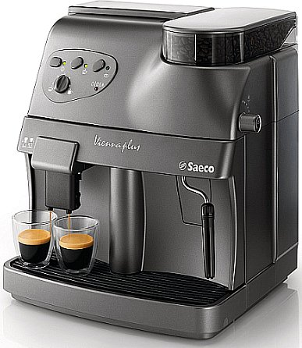
Current State of the Art
Current Market
Semi-Automatic and Manual Machines
Requires outside skills to complete
As precise as the maker cares to be
Why Our Project?
Fast and Easy for the average consumer
Reduced User Interaction
Precision and Repeatability
Notes:
So there are tons of automated espresso machines on the market. Most of them, like this one up here, grind, tamp, and brew but don’t froth on their own, that still needs to be done the old fashioned way. They also expose very few options to the user. In this case, all they give you is three lousy buttons and a knob’s worth of control
.
We want to take that and turn it into a machine where you just put a cup under a spout, press a button, and then BAM, the whole thing’s done.

Slide 4
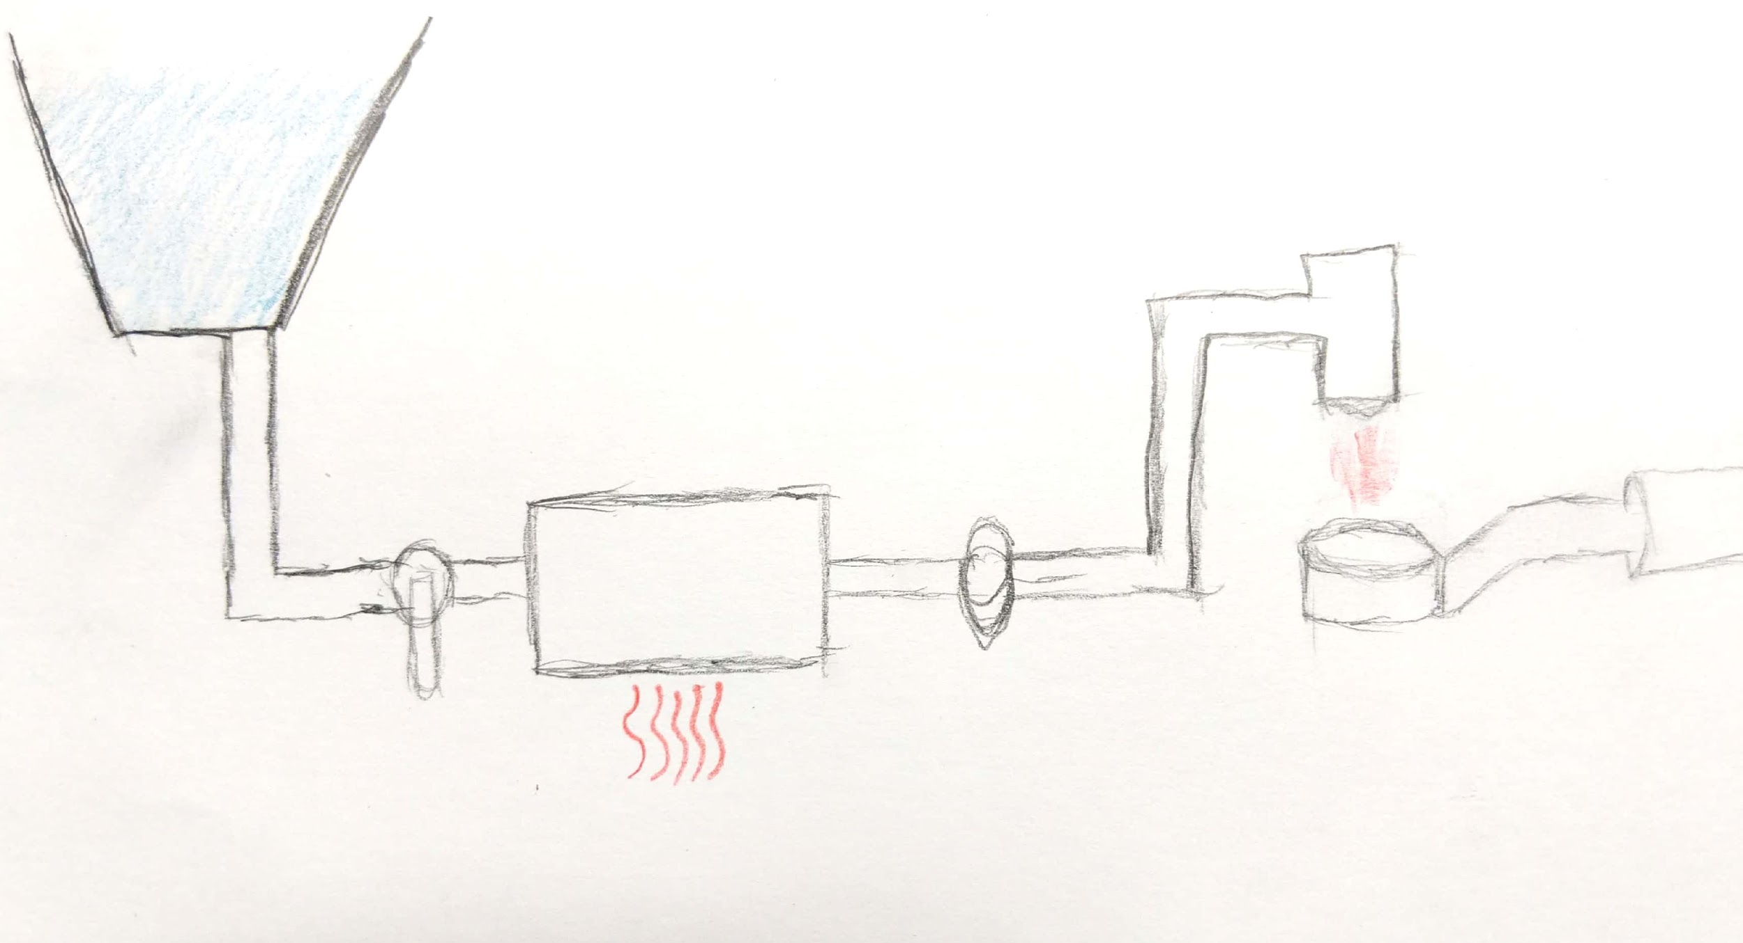
Storage Tank
Valve
Boiler
Pump
Portafilter
Notes:
As you can see by this napkin I scribbled on, the basic operation of an espresso machine brew system is actually pretty simple. There’s a storage tank that holds cold water, when a brewing cycle starts, a valve is flipped that allows water into a boiler. The water is then heated to some predefined temperature at which point an electric pump pushes the hot water through the espresso puck
There’s a lot of variation in exactly how espresso is brewed, but this is the system that we’ll be using.

Slide 5
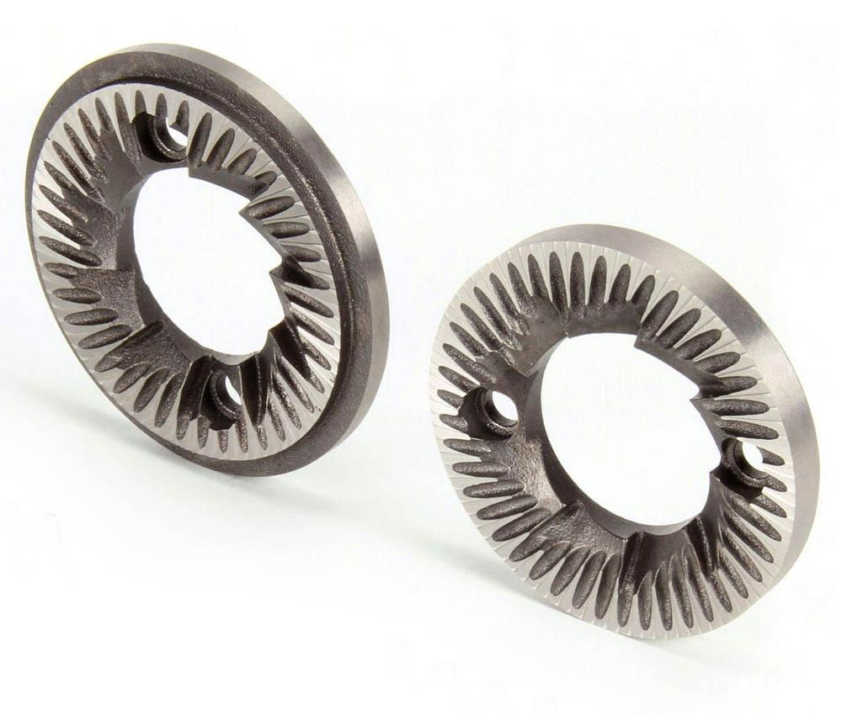
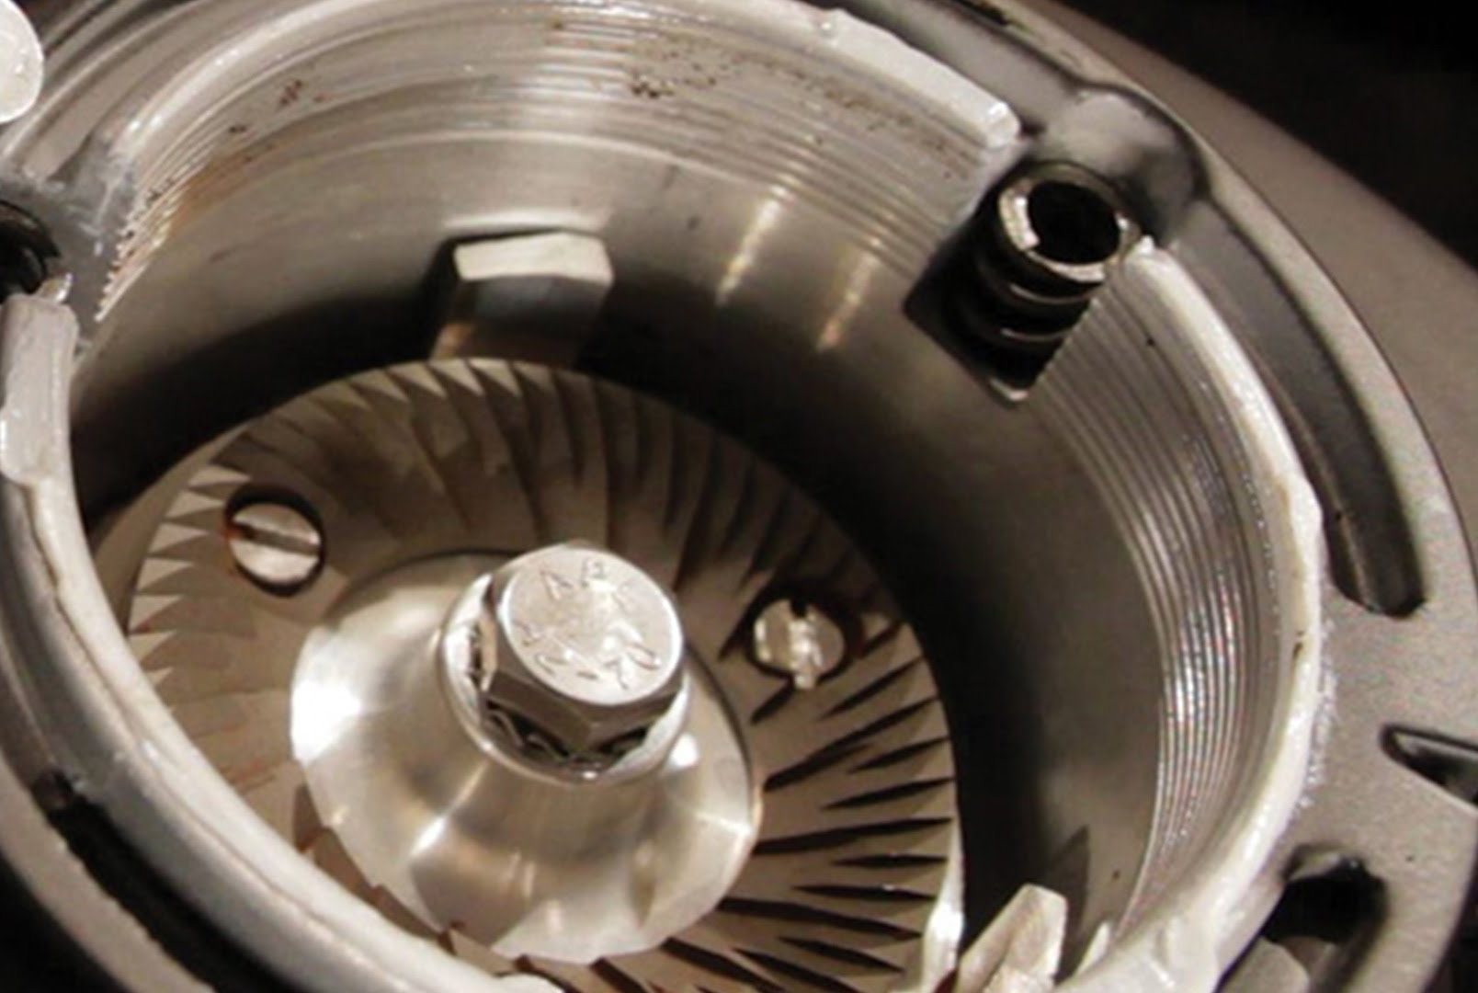
https://www.toomerscoffee.com/burr-grinders-are-best-for-great-tasting-coffee/
Notes:
Our machine will have a (probably) custom built grinder with ceramic burr plates. But we may also just tear down a commercial grinder. Either way, we’ll need to do a bit of work to change the distance between the plates.
We’ll need some way of adjusting the distance between the plates. For that, we’ll use a linear servo

Slide 6
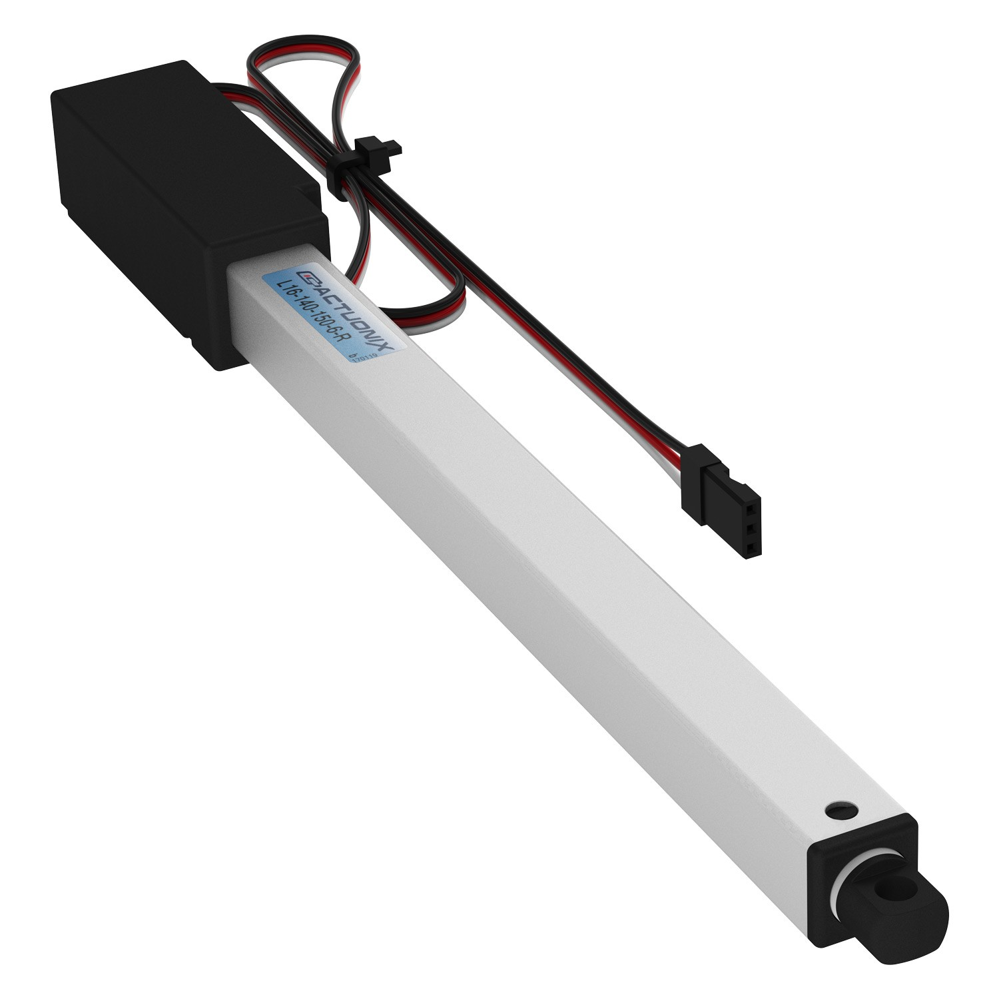
https://www.servocity.com/140-mm-stroke-44lb-thrust-light-duty-linear-servo
Notes:
Like this one from servo city. It works just like a regular servo, except instead of controlling the rotation with PWM, you’re controlling the linear distance.

Slide 7
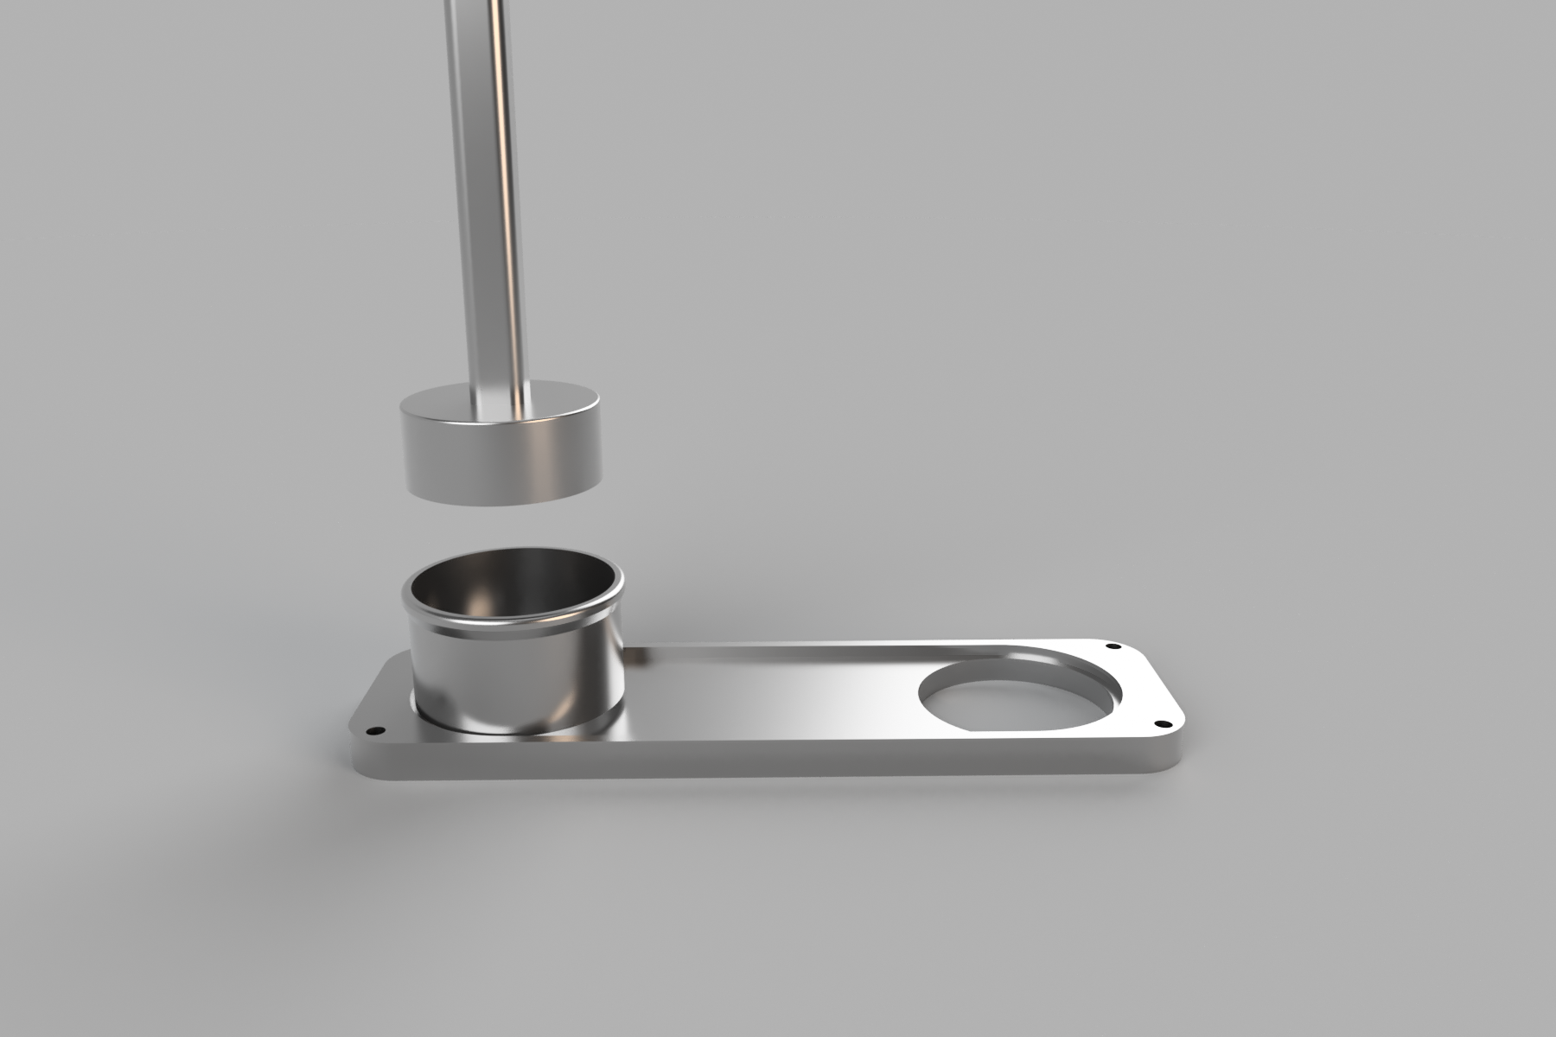
Tamping Mechanism
Presently a black box...
Notes:
After being ground, the coffee will need to be pressed into a tight puck. Ground coffee will fall down a chute and into this container here which will sit on a resistive pressure sensor to determine how much coffee has fallen into the container. When enough coffee has been ground, this thing here will be pushed down into the grounds with a linear servo to compress the grounds. These servos have a surprisingly high force rating, so this should work out just fine. The pressure sensor under the container will be used to determine when the tamper should stop. Once the grounds have been tamped, the container will be pushed over by another linear servo to sit under the outlet of the brewer.

Slide 8
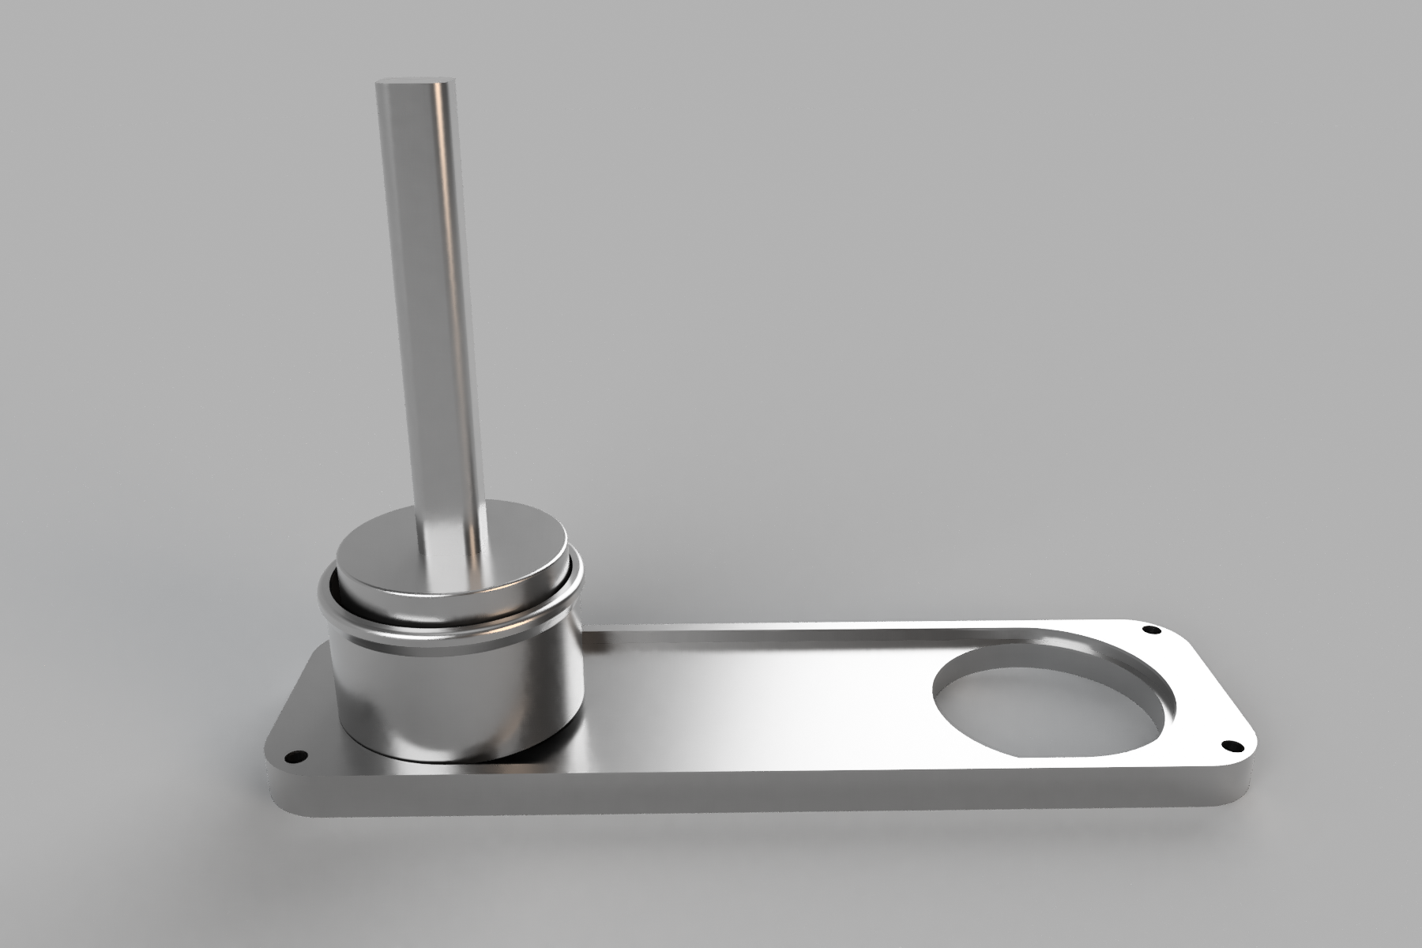

Slide 9
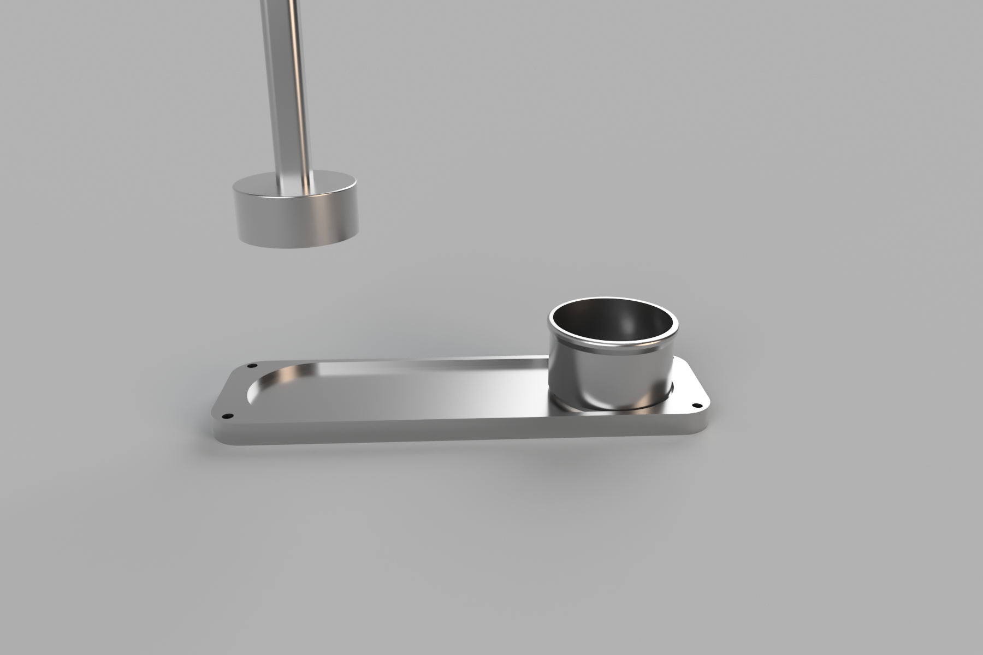

Slide 10
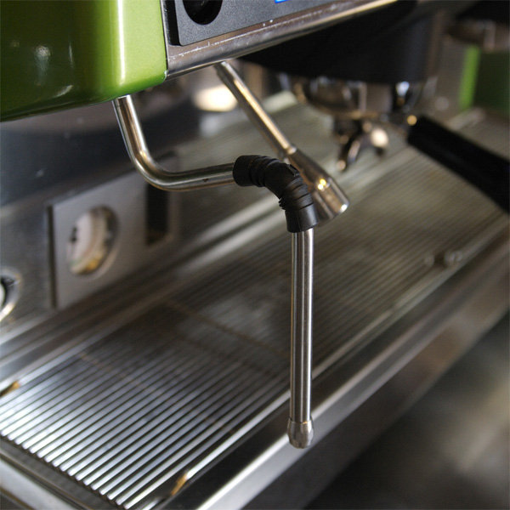
https://www.espressoparts.com/EspressoEquipmentLingo
Notes:
Most all espresso machines have a frother to heat up and froth milk. This works in essentially the same way as the brewer, except the water is heated to a much higher temperature in order to reach a high pressure. Once the water is pressurized, it exits out a rod, or wand, and into a vessel containing cold milk. The high pressure steam heats the milk and causes air to be incorporated into the milk. The amount of air that gets introduced can be controlled by the depth of the wand as well as the amount of time the wand is left in the liquid.
Our machine will have an internal frothing wand made from milled aluminum that can be automatically moved into and out of milk, which will be done in an internal chamber, fed from a refrigerated storage tank.

Slide 11
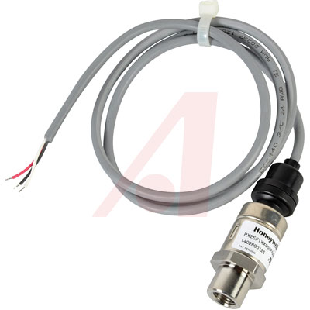
https://www.alliedelec.com/honeywell-px2ef1xx050paaax/70338220/?mkwid=s&pcrid=239075642578&gclid=CjwKCAjw2dvWBRBvEiwADllhn4okncQoyP7h_cfPhN8hTxoUaF3omYR6RLoSX24G-kGMlCR4ucwHMhoChn8QAvD_BwE
Notes:
One of the biggest factors in the frothing of the milk is the pressure of the steam. The pressurized steam will be created by heating water in a sealed container. The generated pressure will be monitored and maintained using a pressure transducer like this, these sensors are usually piezoelectric and generate small voltages under pressure.

Slide 12

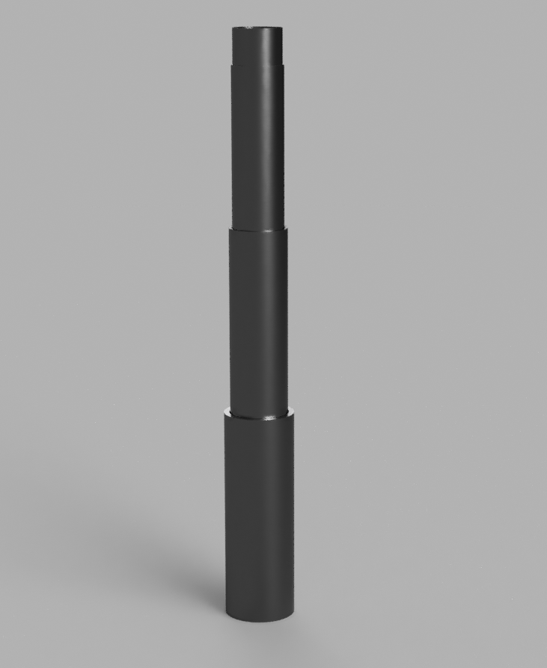

Slide 13
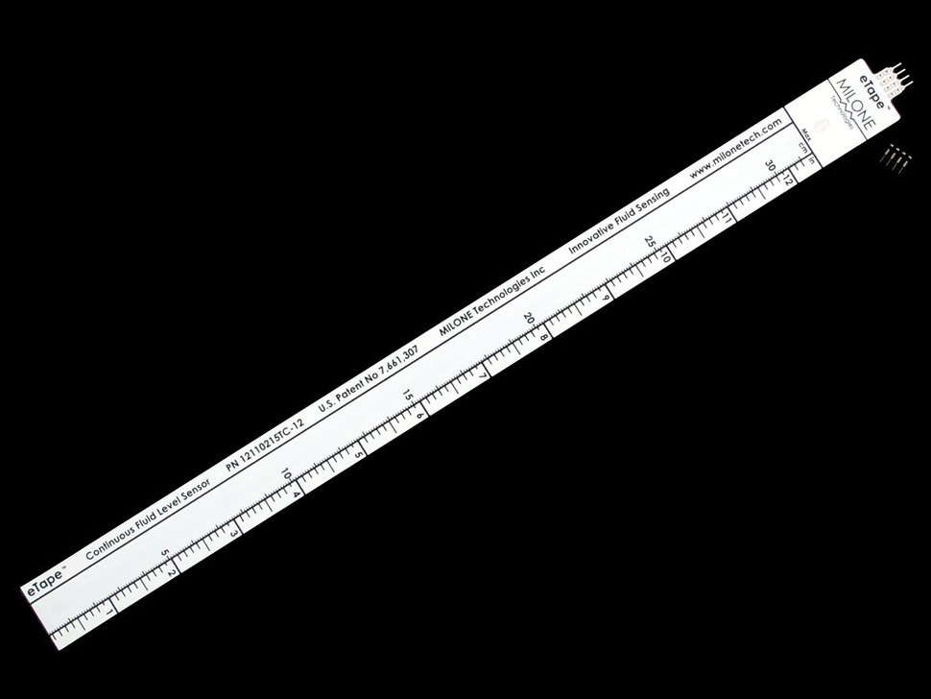
Notes:
For the frothing wand to work effectively, we need to know what the level of the liquid is so that we can determine the right position for straight heating or heavy frothing. To do this, we’ll use one of these resistive eTape level sensors. These could also potentially be used in some kind of feedback system to determine exactly how frothed milk has become since the level of the liquid will rise as it froths.

Slide 14
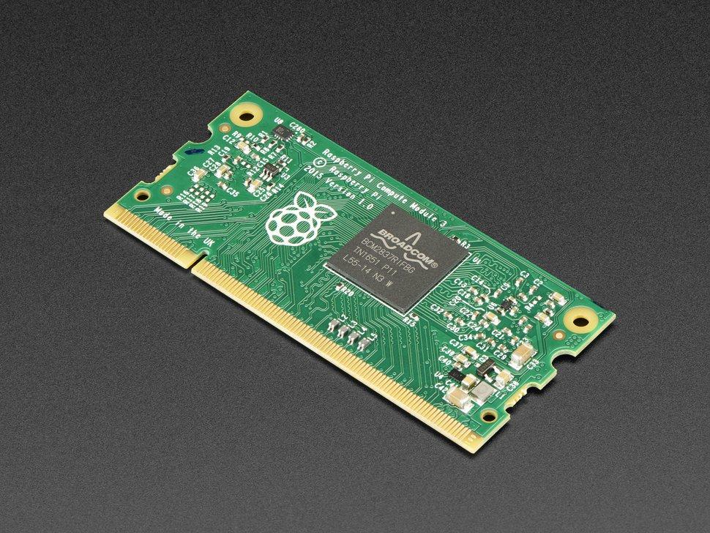

Circuitry
https://www.adafruit.com/product/3440
Notes:
As far as control circuitry goes, we’ll be using a Raspberry Pi compute module and an STM32 microcontroller. A Pi compute module is just a regular raspberry pi, except it connects to a SODIMM slot. The pi will handle all high level tasks like Wifi communications. The STM32 will be used for embedded control tasks like temperature regulation, pressure monitoring, and mechanical control

Slide 15
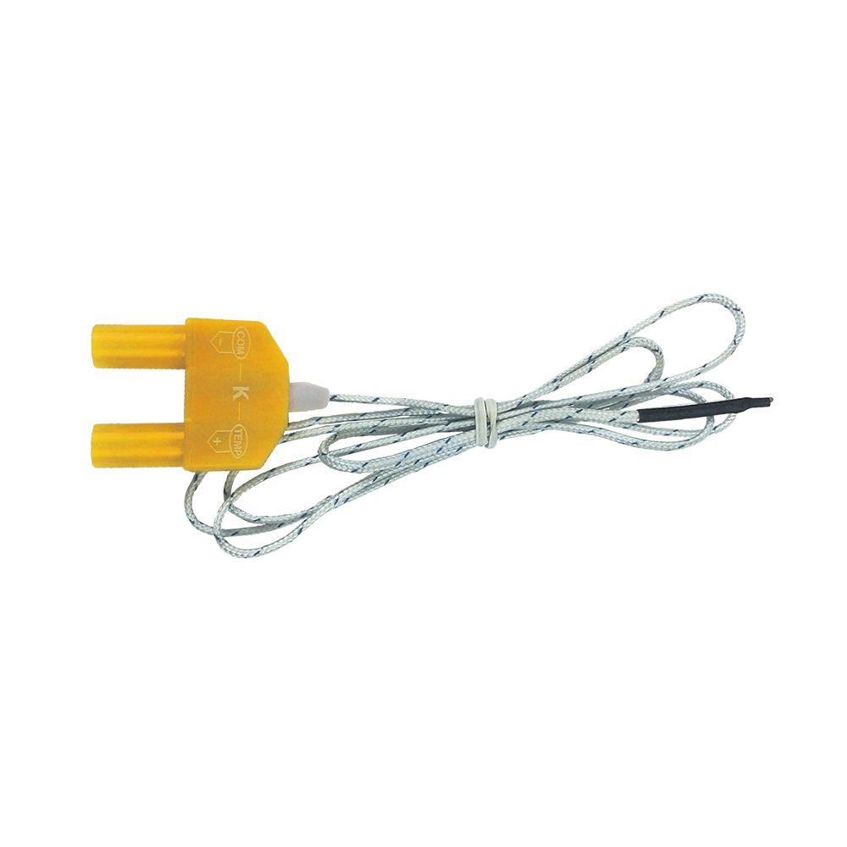
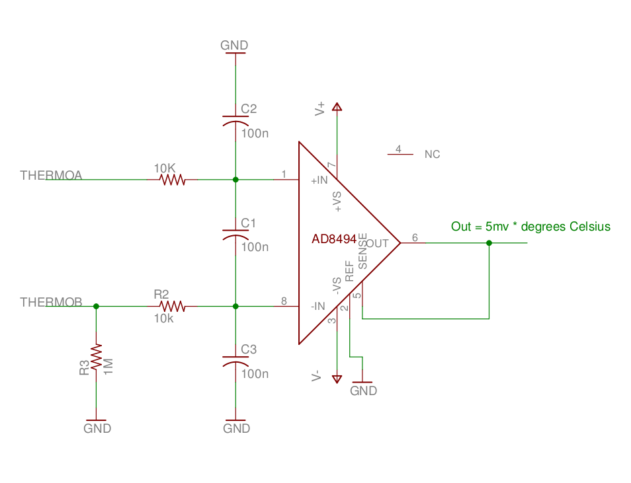
https://www.homedepot.com/p/Klein-Tools-Replacement-Thermocouple-69028/206825565
Notes:
For thermal monitoring, we’ll be using thermocouple wires, which produce a small voltage that correlates to the temperature at the end of the wire, usually an the scale of micro-volts, so it’ll need to amplified using a thermocouple amplifier.

Slide 16
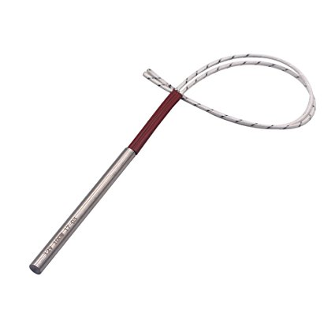
Notes:
As heating elements, we’ll be primarily using these resistive cartridge heaters. To regulate temperatures, we’ll have a microcontroller driven relay connect and disconnect the heaters from the mains like a thermostat.

Slide 17
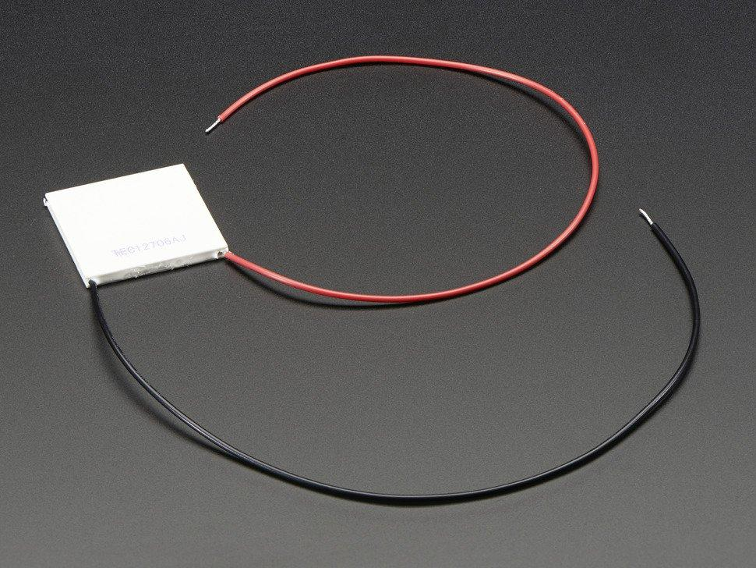
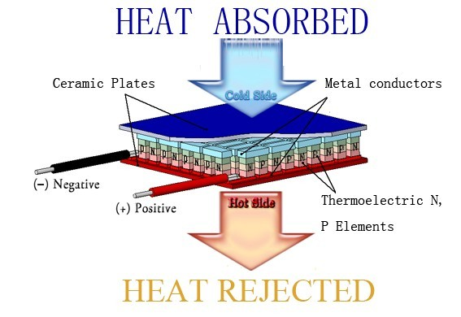
http://www.huimao.com/about/show.php?lang=en&id=4
https://www.adafruit.com/product/1330
Notes:
To keep milk cool, we’ll use peliter elements attatched to a metal storage tank. A peltier element produceds a temprature drop when current is applied to it.

Slide 18
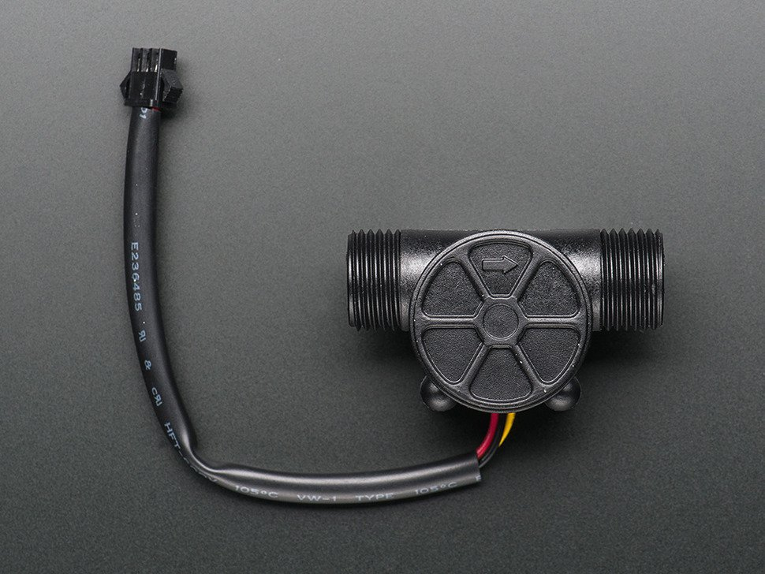
https://www.adafruit.com/product/828
Notes:
To measure how much liquid is used for one task or another, we’ll be using a hall effect flow meter. These put out an electric pulse for every 2.22mL of fluid that passes through them. We’ll count the number of pulses they put out using one of the capture/compare channels on the STM32 and use that to determine the flow rate and amount of liquid that’s been used.

Slide 19
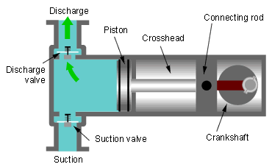
https://engineering.stackexchange.com/questions/200/what-are-characteristic-values-for-a-piston-pump
Notes:
We’ll use a piston pump to push hot water through though the brewer. Piston pumps are good for this because they can produce high pressures and are generally resistant to heat.

Slide 20
Pump Control
Vary pump voltage with a motor controller to control pressure/flow rates

Slide 21
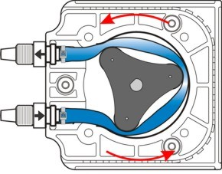
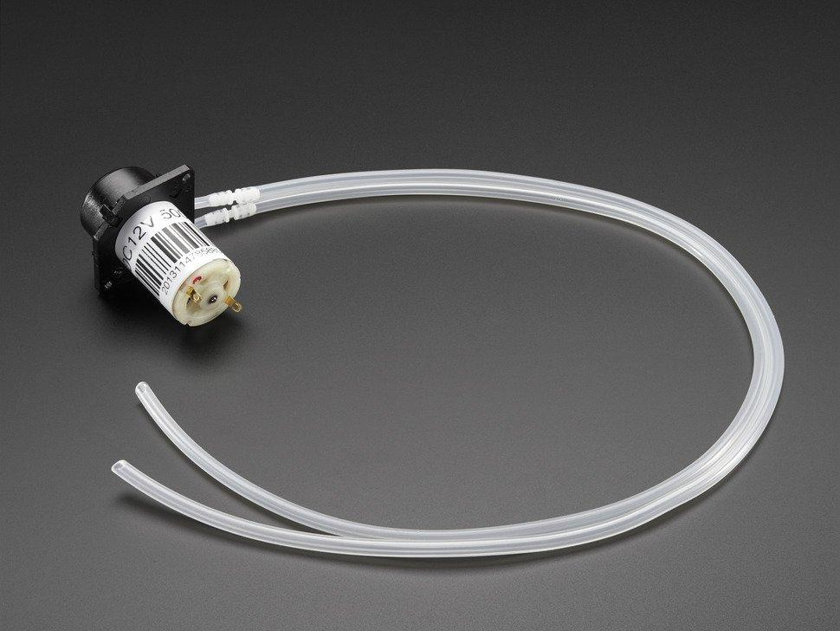
https://www.blue-white.com/confessions-of-a-chemical-feed-pump-manufacturer/
Notes:
For pumping everything else like milk and flavoring syrup, we’ll use small peristaltic pumps which pump liquid by compressing a rubber tube. These are nice because they’re genarally food safe and inexpensive.

Slide 22
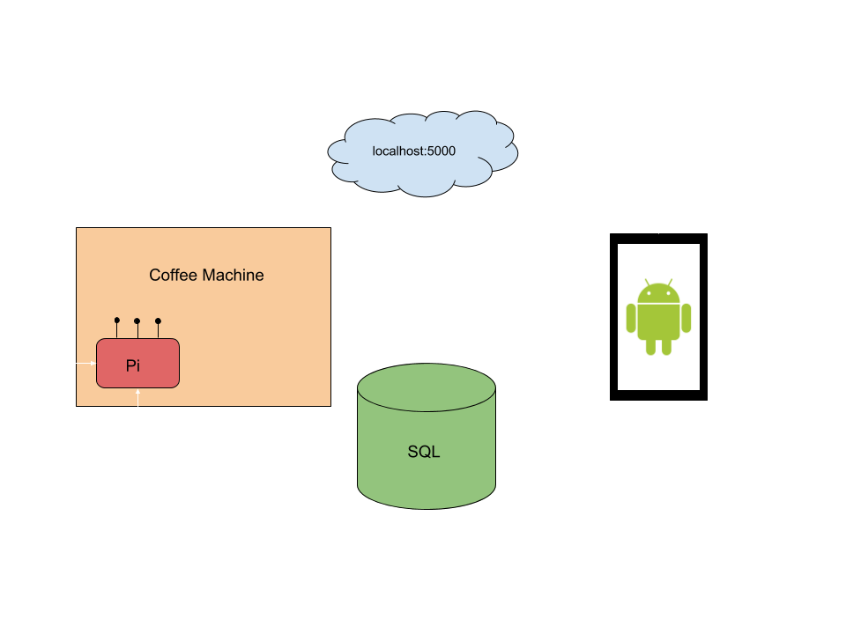
Project Overview
Stretch Goal
Notes:
We will now use this boring block diagram that looks like all the others you’ve seen this week to explain how the general data flow will work.
SEAMLESS TRANSITION

Slide 23
Mobile Application
Creating basic user interface for users to personalize a beverage.
Connection with machine via wifi
Use http communication with Raspberry Pi to send and receive information
PSI, Temperature, Grinder, Amounts, etc.
STRETCH
Implementing user profiles
Features such as Recents, Favorited, Scheduled, Search, Recommended

Slide 24
What to send?
Brew http calls will contain various integers
Water /Milk Temperature (limited of course, we don’t want lawsuits)
Frothing/Water Pressure (PSI)
Amount of milk (Oz.)
Amount of water (Oz.)
Froth intensity (Value from 0 -100)
Syrup amount/type (Oz. and selection)
Fineness of coffee (Value from 0 - 100)

Slide 25

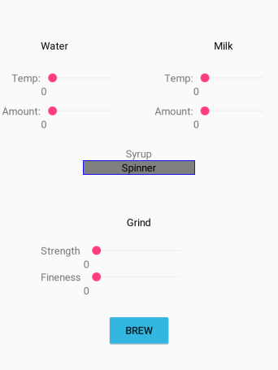
Main UI Layout Mockups
Notes:
Here are just a few layouts on what might be expected. Just to sort of get an idea of what we hope to implement.

Slide 26
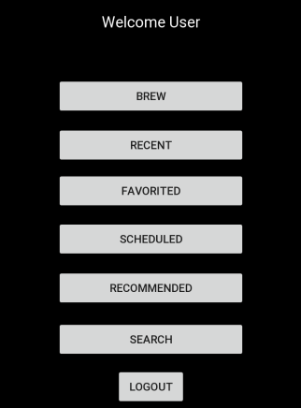
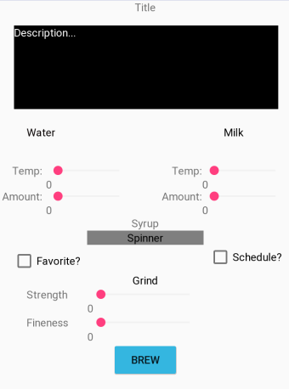
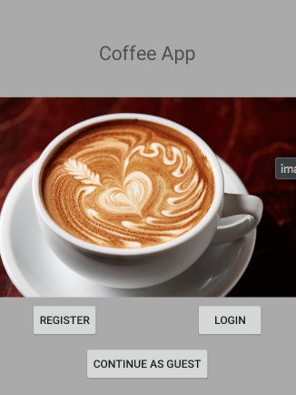
STRETCH Mockups

Slide 27
Database Goals (Stretch)
Use a database such as Google’s Firebase or AWS
Easily integrated with Raspberry Pi
Implement user profiles
Mobile application will send login info and receive info
Data aggregation for features like Searching and Recommendations
Allow users to upload drink recipes, scheduled posts about machine statistics
Database searches based on device key

Slide 28
Flask
Flask is a Python MicroFramework that assists in the creation of websites.
We will be using it as a REST server that is running on a Raspberry Pi.
This Provides us with
Access from anyone on the network
Reliability through HTTP
Acts as a middleman between the Android Phone and the microcontroller

Slide 29
Rest API Breakdown
Am I connected?
Call to see if device is reachable
Make me a coffee
Call to initiate coffee making process
Give me data
Request for specific data to be pulled from database (Stretch Goal)

Slide 30
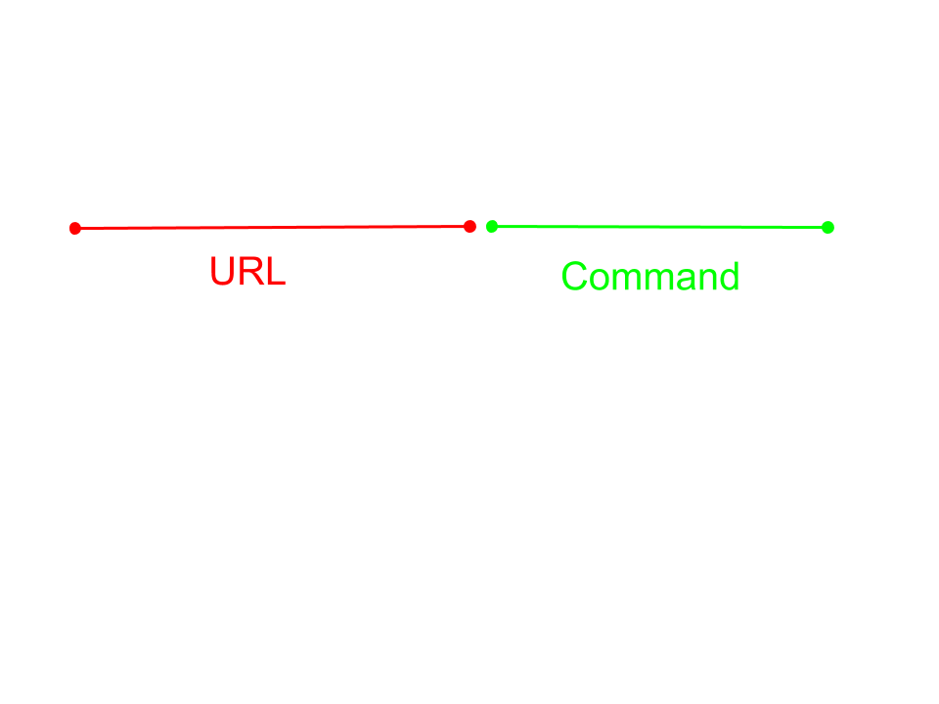
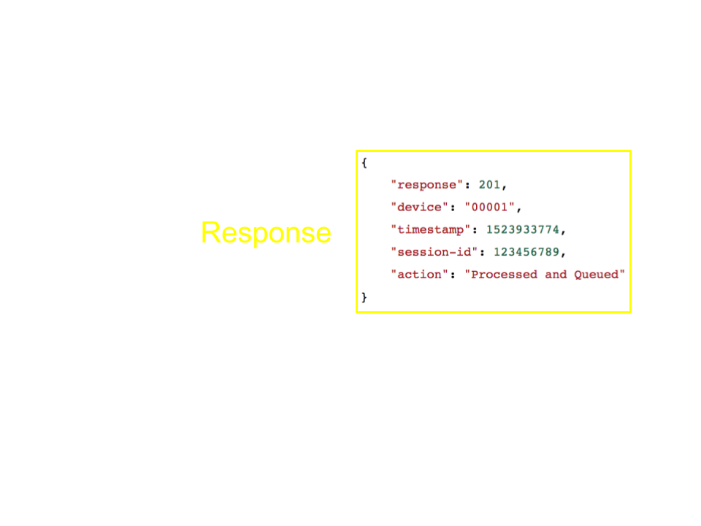
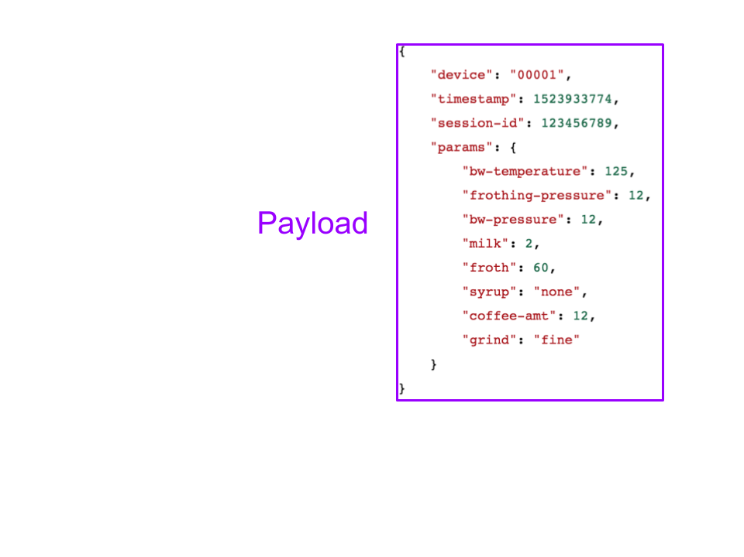
Flask Requests
Flask will setup the website http://127.0.0.1:5000 for anyone on the local network to reach.
It will recognize valid requests as having the machine serial number in the json payload.

Slide 31
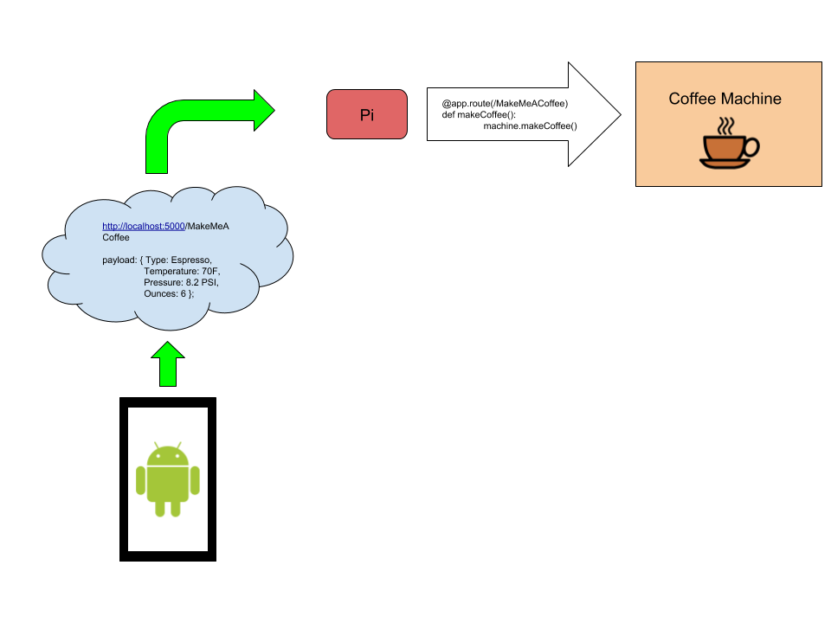
Demonstration
At the project demonstration, the machine will be setup with an Android tablet and loaded with ingredients.
Visitors will be invited to use the tablet to create a drink of their choosing, demonstrating varying selection possibilities.

Slide 32
Questions?
Notes:
We will now answer whatever asinine questions you’ve managed to come up with.

